Slide 1
Natural Language to SQL Query System
Team:
Shaik Kalesha Vali
Chodavarapu Chandrasekhar
Kavitha Parimi
Subham Kumar
Kunja Lokesh

Slide 2
Problem Statement : Challenge in Modern Banking
Financial analysts & Customer Support Representatives need frequent data access
Lack SQL skills → dependency on technical staff
Delays impact customer service & decision-making

Slide 3
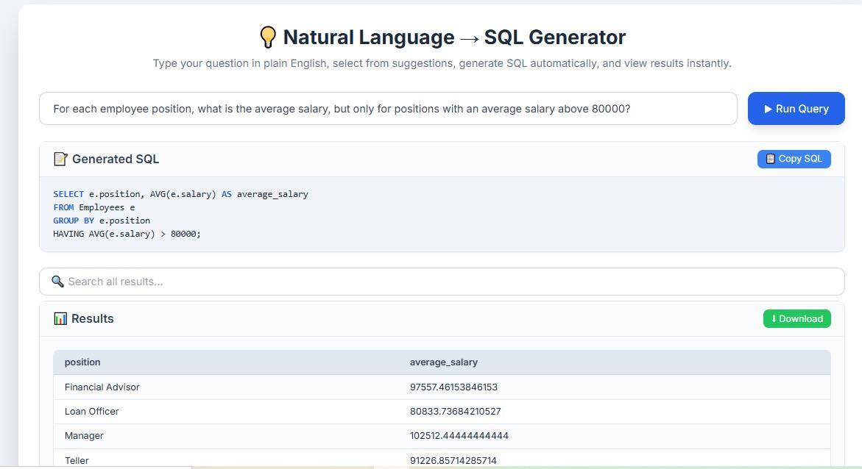
Solution : Our AI-Powered NL → SQL Solution
Accepts Natural Language questions
Converts to accurate, executable SQL
Provides explanations + previews
Built for banking transaction data

Slide 4
Key Functional Features
Export/Download results in multiple formats (CSV, PDF, Excel)
SQL Translation accuracy & correctness
Handle query complexity (joins, aggregations, filters, where, limit)
Notify vague/unclear inputs → suggest clarifications
Contextual understanding (user intent + schema awareness)

Slide 5
User Experience Flow
User types question
System suggests interpretations
Preview SQL + reasoning
User approves/edits
Execution → results table
Export/Save

Slide 6
Impact & Future Scope
Empower non-technical staff with self-service analytics
Faster decision making in banking operations
Reduce dependency on technical teams
Future: support voice queries, multi-DB integration

Slide 7
Thank You

